Slide 1

Linear Regression

Slide 2
Contents
1. What is linear regression?
2. Why do we use Linear Regression?
3. A realistic Example
4. How does the Machine find the ‘best’ line?
5. Gradient Descent
6. Polynomial Regression
7. Multi variate linear regression
8. Linear Regression in real life
9. Coding

Slide 3
What is Linear Regression?
Linear – Line
Regression – relation between data points – dependent variables and independent variable
Find the relation between X and Y in the following cases:-
Experience writing novels in yrs (X) | No. of novels written (Y)
1 | 3
2 | 6
3 | 9
4 | 12
5 | 15
Initial no. of rabbits (X) | Total rabbits after 1 year (Y)
4 | 8
6 | 27
8 | 64
10 | 125
12 | 216

Slide 4
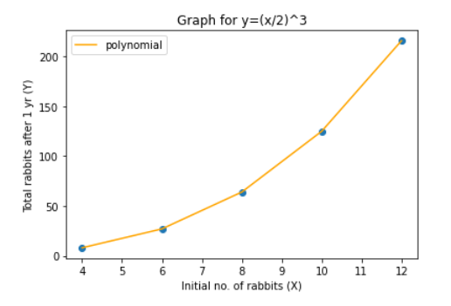
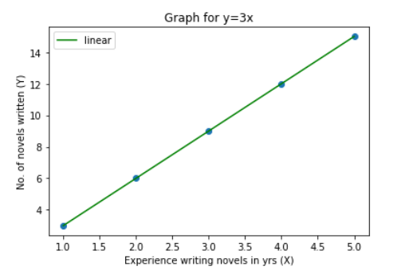
Why do we use Linear Regression?
When x = 7, y ≈ 5 (42.875) ; x = 9, y ≈ 90 (91.125)
We can now predict Y if we have any value of X

Slide 5
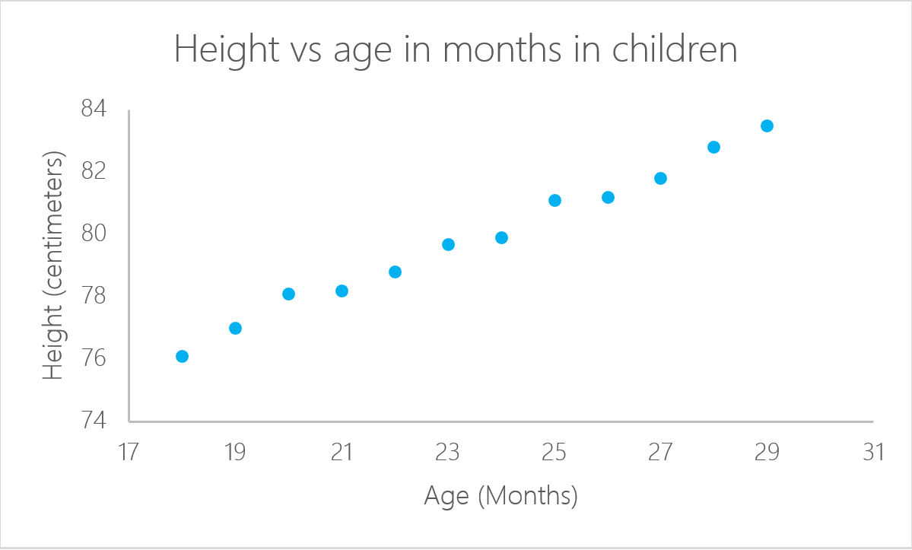
A realistic Example
After plotting the line, we can get the height for any given age.

Slide 6
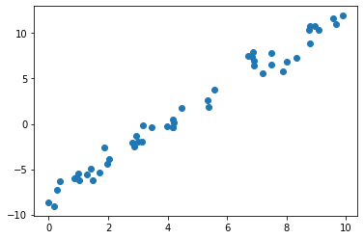
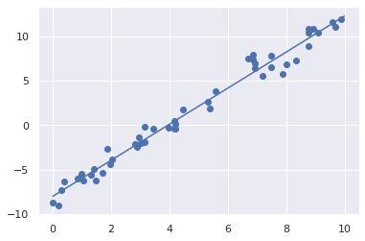
A random set of points
Finding the best line to represent those points

Slide 7
How does the Machine find the ‘best’ line?
We give the machine a lot of data and ask it to find the line passing through majority of the points.
For a line y = mx +c, m and c are the parameters of the line.
The Machine needs to adjust ‘m’ and ‘c’ so that it gets the best line representing the given points. m and c are known as hyper-parameters.
Tweaking m and c will help us predict the generalized line that passes through most of the data and we can thus find a general pattern in the data.

Slide 8


How to get the values of ‘m’ and ‘c’?
We initially take random values of m and c so as to get a random line, define a function to measure how ‘good’ the line actually is, and modify the m and c values accordingly.
We’ll call the function to be used as loss function. It will take the line (m and c values) and give us a measure of how good that line represents our data.
For that , we calculate the error, which is the difference between actual value (data point) and predicted value (given by a particular line). We calculate the sum of such errors for all the data points and that gives us the total error in a particular representation of line.
We took the square of difference as we need absolute value of error

Slide 9
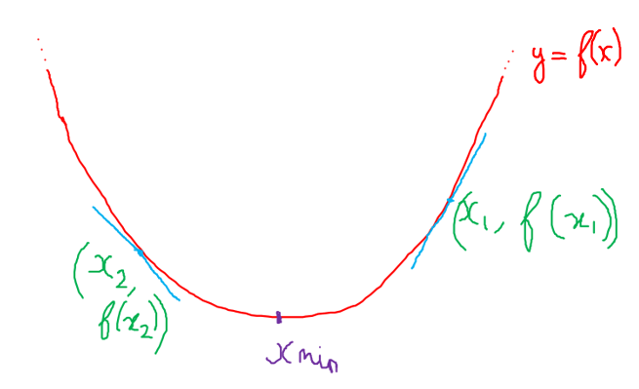
Minimizing the error would make the line pass closer and closer through the majority of the data points
But how do we find the minima of the loss function?
Enter Gradient Descent

Slide 10
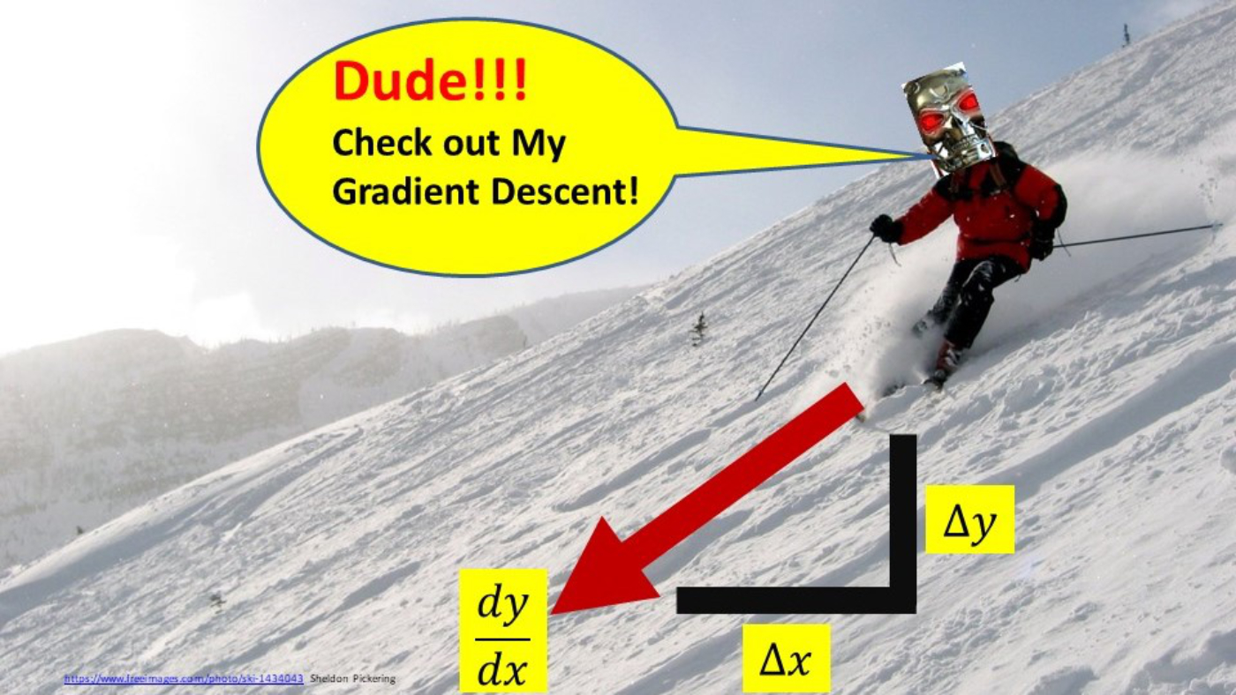
Gradient Descent
Gradient Descent is an iterative algorithm used to find the minima of a particular function. Or in our case, it is used to calculate the values of m and c such that the error generated is minimum
Refer Graph – Derivative gives direction, Learning rate gives step size
Larger learning rate = bouncing back of x value, lesser learning rate = more iterations
Epoch = total no of iterations

Slide 11
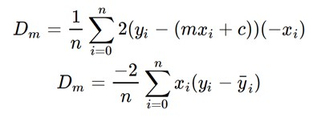

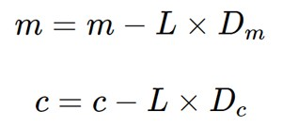
To get ideal values of m and c, we define y = f(m) and y = f(c) separately, calculate the best values of m and c individually and then we get the best line with those values of m and c
Partial Derivative wrt m: Partial Derivative wrt c:
In each iteration, we do:
Finally we get m and c with accuracy depending on the epoch

Slide 12
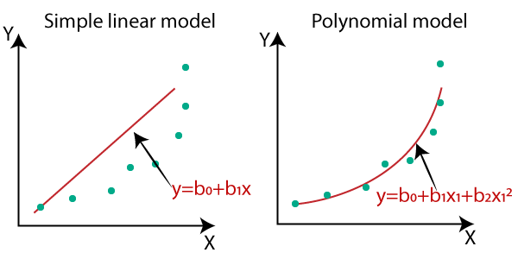
Polynomial Regression
y = p(x) instead of linearly depending on x
Same steps as linear regression, only we assume y is a quadratic in x or cubic in x and so on.
For e.g. in y = ax² + bx + c, we will have to do the gradient descent algorithm for all the unknown parameters, a, b, c to get the most appropriate quadratic passing through our data points

Slide 13
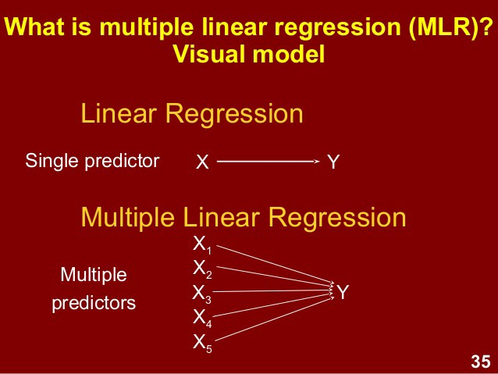
Multi variate linear regression
Dependent variable y is dependent on more than 1 variables /features. y = ax1 + bx2 + cx3… + d. For e.g., y = ax1 + bx2 + cx3 + d
We have the data of all the features, i.e., x1, x2, x3 ...
Same method as regular linear regression, only here we take x1, x2, x3 simultaneously into consideration rather than just single variable x.
In above e.g., we need to find values for a, b, c, d such that loss function is minimum.
So we apply same concept and use gradient descent algorithm 4 times to get the most appropriate a, b, c and d values.

Slide 14
Linear Regression in real life
Businesses often use linear regression to understand the relationship between advertising spending and revenue
revenue = β₀ + β₁(ad spending)
Medical researchers often use linear regression to understand the relationship between drug dosage and blood pressure of patients.
blood pressure = β₀ + β₁(dosage)
Agricultural scientists often use linear regression to measure the effect of fertilizer and water on crop yields.
crop yield = β₀ + β₁(amount of fertilizer) + β₂(amount of water)

Slide 15

Let’s Code

Slide 16
References
https://qph.fs.quoracdn.net/main-qimg-f4ee981809b71a7d5830e7b6ff8b8282
https://towardsdatascience.com/linear-regression-using-gradient-descent-97a6c8700931

Slide 17
THANK YOU

